Slide 1


User
Timer
UI
AppManager
Logic
Storage
Model
Main
Game
Logs Centre
Commons
Notes:
Architecture Diagram

Slide 2




WordBank 1
WordBank 2
WordBank 3
Word
Word
Word
Word
Word
Word
Meaning
Meaning
Meaning
Meaning
Meaning
Meaning
Word
Word
Word
Word
Word
Word
. . .
Meaning
Meaning
Meaning
Meaning
Meaning
Meaning
Choose a WORDBANK!
START
GAME!
Choose a DIFFICULTY!
EASY
MEDIUM
HARD
Notes:
Overview Diagram

Slide 3
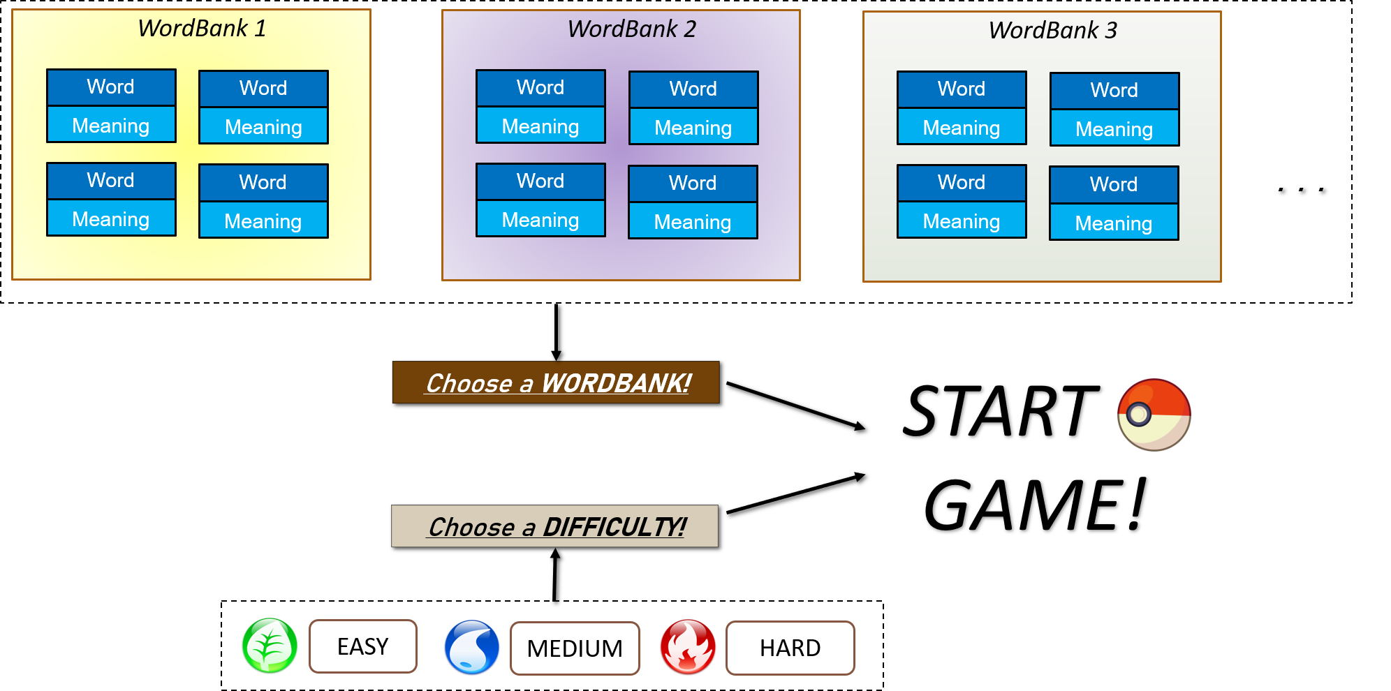
Notes:
Rendered Version

Slide 4
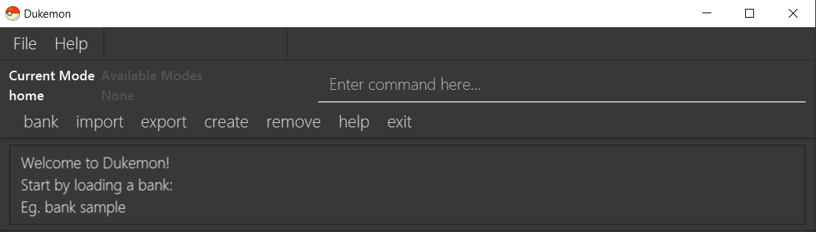
Enter commands here
Command feedback shown here
Notes:
Command Box diagram

Slide 5
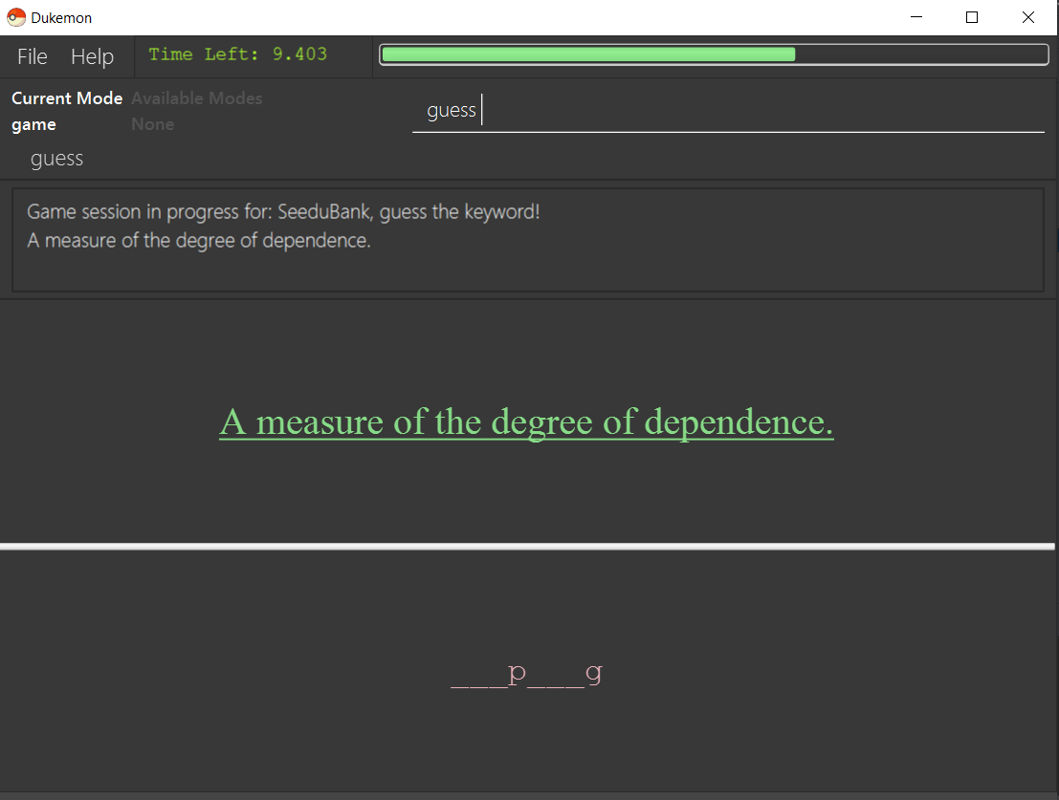
Time left for current Card
Current Card’s Meaning (to guess)
Current Card’s
hangman-style Hints
Notes:
UserGuideGameSessionDiagram1

Slide 6
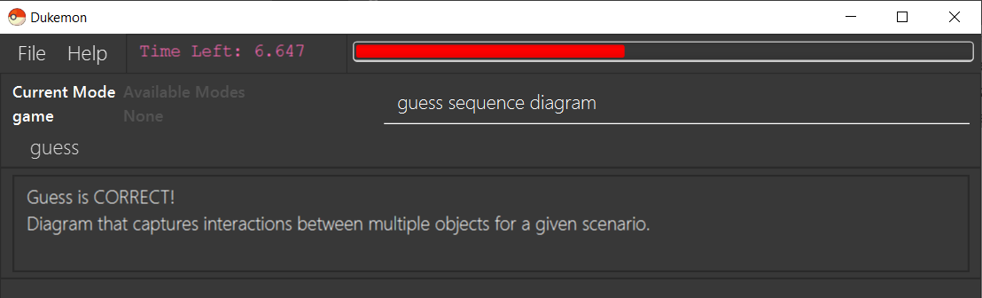
Timer changes colour when time is running out
Feedback for each Guess
Notes:
UserGuideGameSessionDiagram2

Slide 7
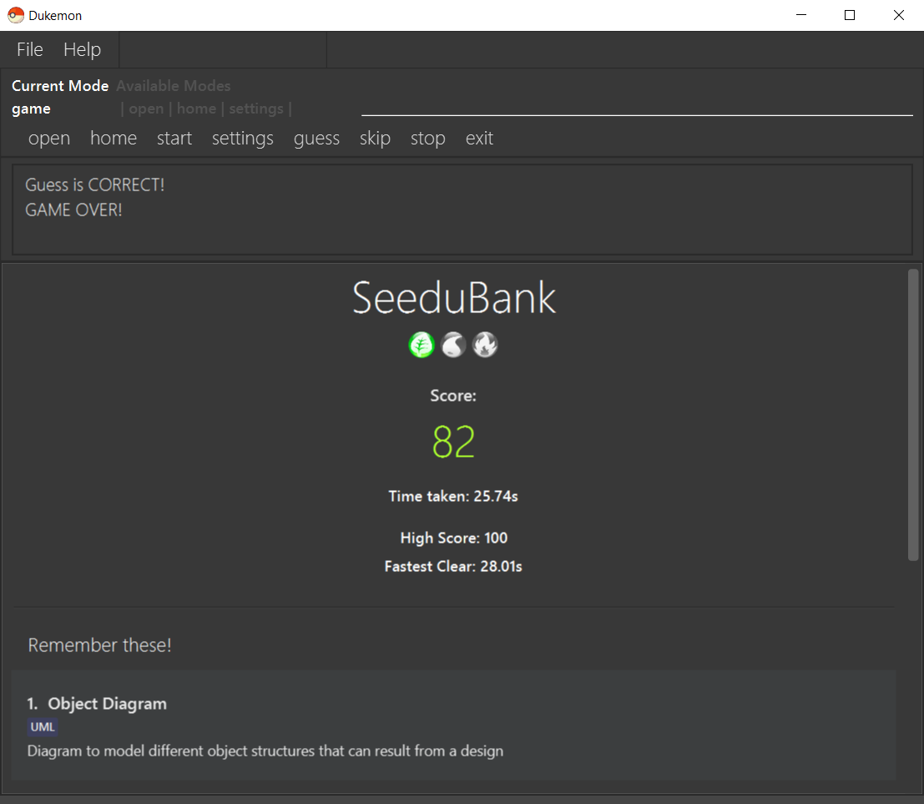
Game Result and
Statistics are shown here
Cards answered wrongly shown here
Notes:
UserGuideGameOverDiagram

Slide 8
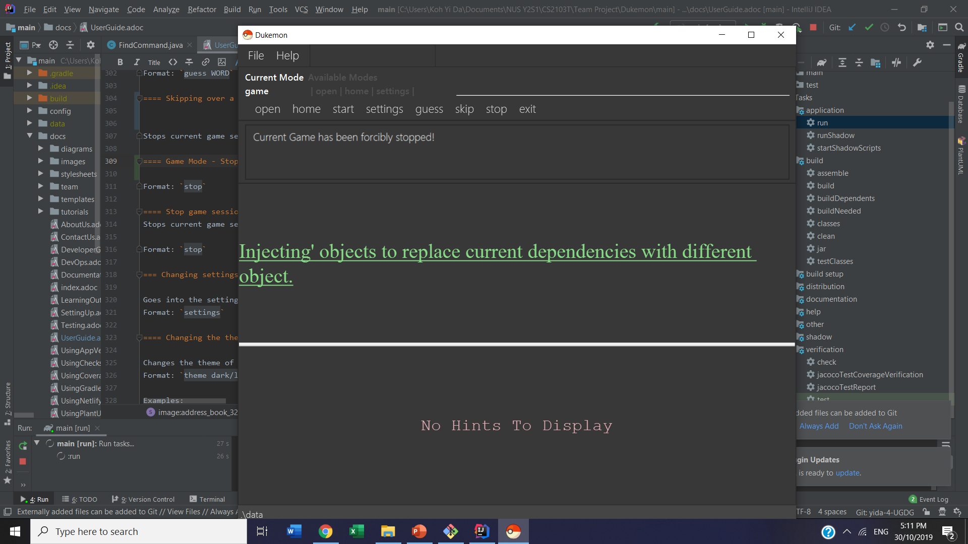
Feedback when Game
is stopped

Slide 9
Game Finished
Game Stopped
Feedback when Game
is stopped
Game Result and
Statistics are shown here
Cards answered wrongly shown here

Slide 10
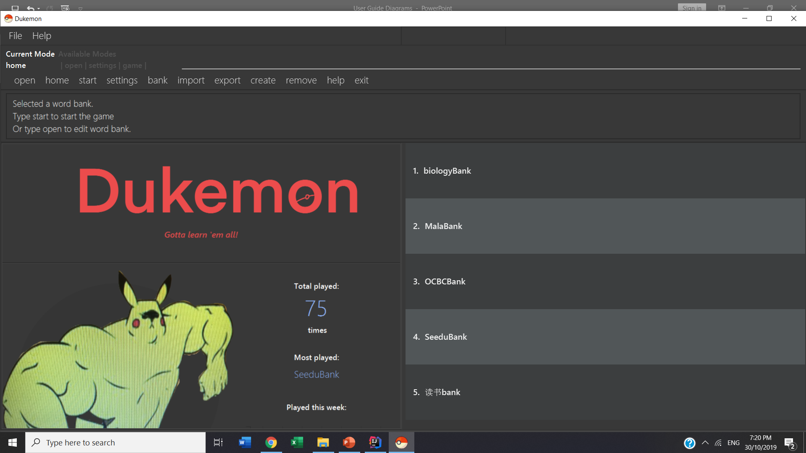
Notes:
UI Pic

Slide 11
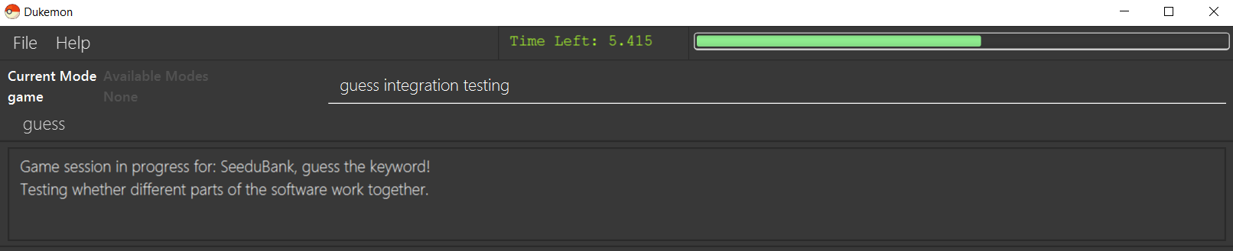
Timer feature that
updates in Real Time

Slide 12
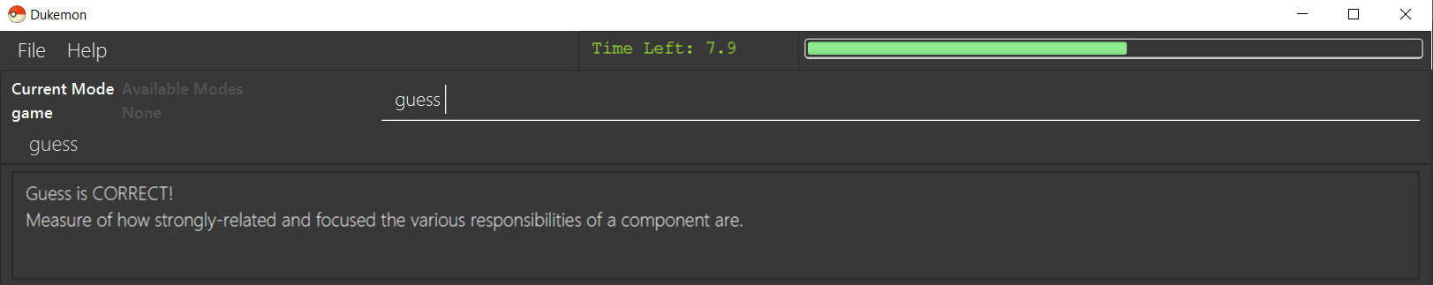
Timer feature that
updates in Real Time

Slide 13
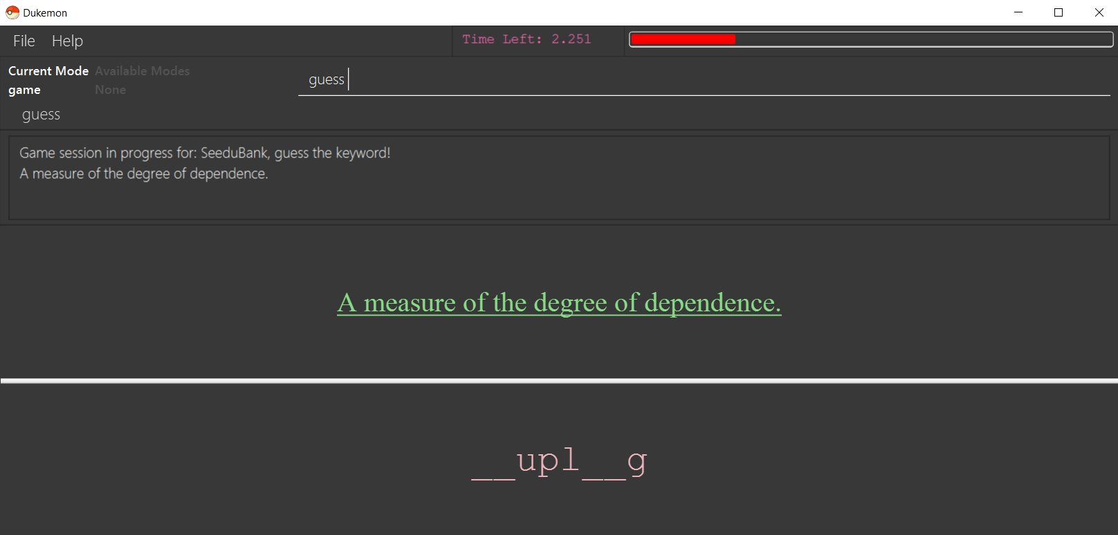
Automated Hangman-style Hints

Slide 14
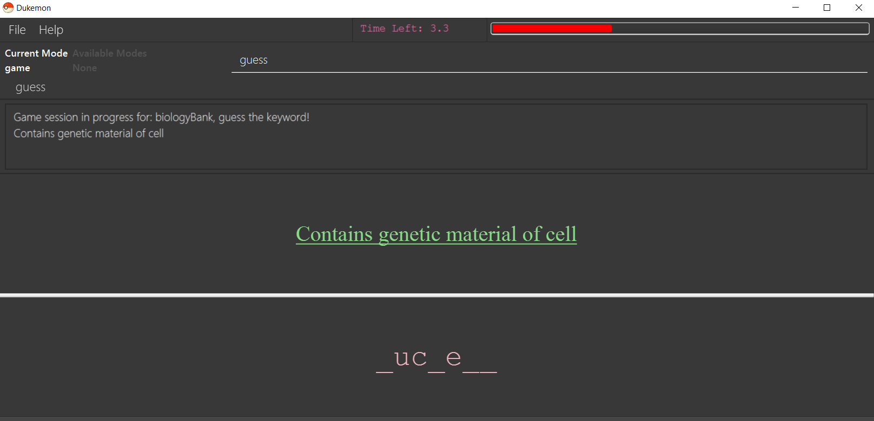
Automated Hangman-style Hints

Slide 15
